Slide 1
LITERATURE REVIEW Design of tri-band flexible CPW 4-port slot MIMO antenna for conformal 5G, WIFI 6/6E and X-band applications
GROUP MEMBERS
CALVIN SEWORLUM MAWULORM
JESSICA ELIKPLIM TSITSIA
BERNARD KOBINA FORSON ESSEL
PROJECT SUPERVISOR: Dr. K. S. O. Kwakye

Slide 2
INTRODUCTION
Imagine a cell phone that could connect to your 4G network, your Wi-Fi, and even a super-fast network, all at the same time.
That's the kind of versatility this research paper explores, but instead of a cell phone, it's about designing a single antenna that can do all that by combining UWB and MIMO technology can enable the communication system to realize long-distance stable and high efficiency information transmission.
THE TRI-BAND ANTENNA
INVERTED L-SHAPED SLOT
U-SHAPED FLOOR PLANE
DUAL VERTICAL GROUNDING CONNECTION

Slide 3
This is a bendable circularly polarized antenna that operates at 2.45 GHz. The wearable antenna with flexible dual-band and dual-mode design is proposed in which uses a mixed dielectric substrate for in vitro and in vivo communication
The innovative points of the antenna include:
(1) Using flexible liquid crystal polymer (LCP) dielectric substrate, which has important research value in the conformal wireless applications.
(2) The feeding of CPW is easy to integrate into the circuit.
(3) The 4-port MIMO antenna has high isolation better than 25 dB and low ECC less than 0.01, and the flexible antenna can operate at bending states.
(4) Coverage of three bands 5G N77/78(3.3–4.2 GHz), WIFI 6/6E (5.15–5.83 GHz, 5.925–7.125 GHz) and X-band (8.5–10.68 GHz) satellite communication, which is suitable in the field of 5G and future 6G applications.

Slide 4
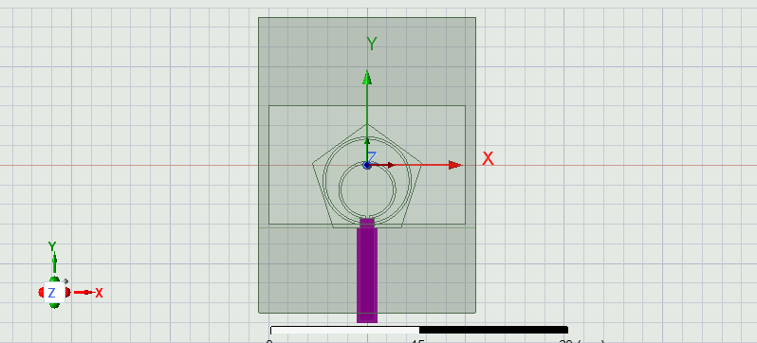
ANTENNA PROGRESS

Slide 5
THANK YOU

